Slide 1

Python
By:Umer Farooq

Slide 2
Introduction
Computer Faculty Member In SZABIST ZABTech(iTVE) Hyderabad
Working In Part time in Software House in GBS
Providing a Domain and Hosting
Providing Microsoft Certificate
Also part of a Digital Marketing Company The Vision

Slide 3
What is Python?
The world’s fastest growing programming language
It is easy to learn

Slide 4
Field of python
Software Engineers
Mathematicians
Data Analyst
Scientists
Accountants
Network engineers

Slide 5
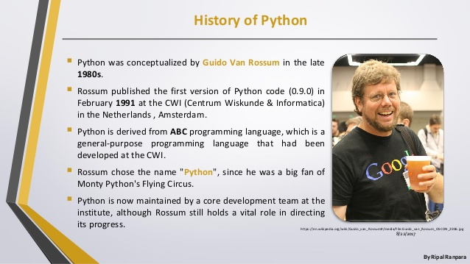
History

Slide 6
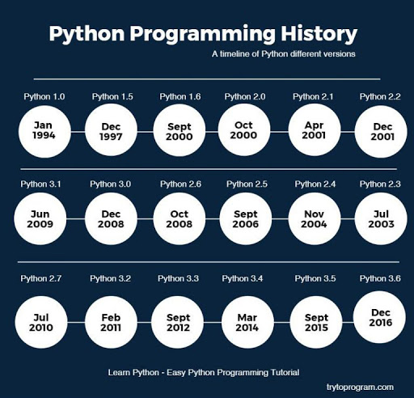
verions

Slide 7
Reason 1
Solve complex problems in less time with fewer lines of code
Example
First 3 letters of hello world
C# str.Subtring(0,3)
Js str.substr(0,3)
Python str[0:3]

Slide 8
Reason 2
High level
Huge community
Cross platform
Large ecosystem

Slide 9
What you can do in python
Web Development
Machine Learning
Data Visualization
Scripting
Game Development
Desktop Application

Slide 10

Web Development
Web Framesworks like Django and Flask which are based on python has recently become very popular
these frameswork helps you to create server side code that’s run on server

Slide 11
Why Web Framesworks?
Help build common logic
Mapping urls to python code
Dealing with databases
Generating html files
For beginner you should start with flask

Slide 12
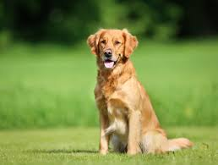

Machine Learning
Example
What’s in a picture?
You write program to
recognize
So you start to write a
code for them
Like lots brown color is a
Dog may be it’s a dog and
Lots of straight edges may
Be a table

Slide 13
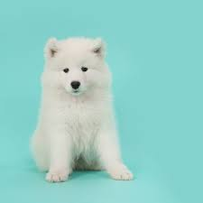
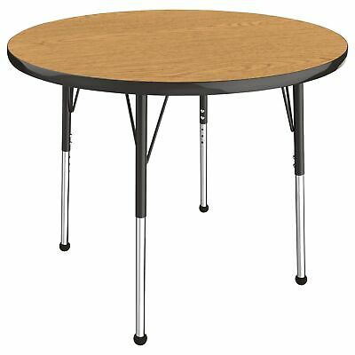
A picture which has not any
Brown hair
A table with the rounded
Corner
Now machine learning comes

Slide 14

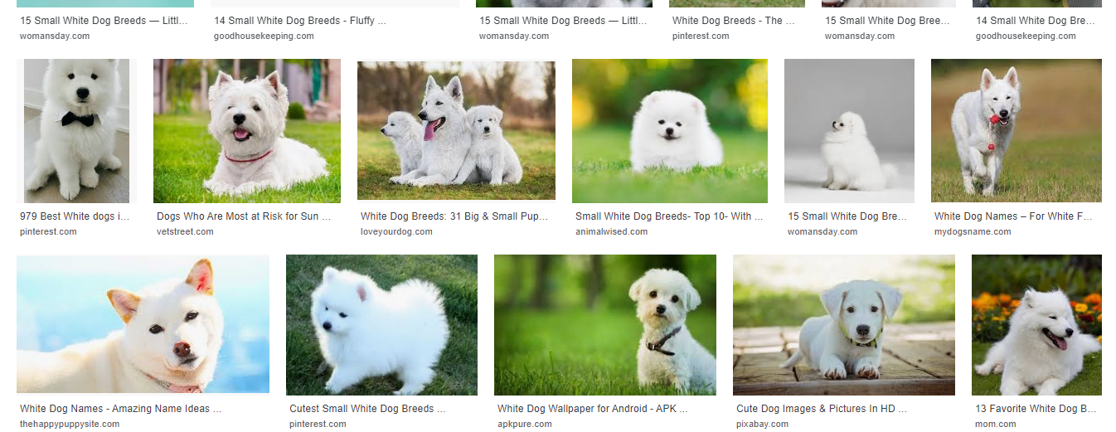
So in this example you can give 1000 dogs picture and 1000 tables pictures
Also use these ideas to recomadation like utube

Slide 15
Power Machine Language Network
Neural Network
Deep Learning
Support Vector Machines
Random Forest
These all can to solve picture problem which I told Earlier

Slide 16
Popular framework of Machine Learning
Scikit-learn
The most popular machine learning algorithm built in
Firstly recomended
Tensor flow
When you usually familiar with Machine Learning use tensor flow
If you want to start learning this I recommended
Stanford’s or Caltech’s machine learning course (coursera)
After this kaggle website help you

Slide 17
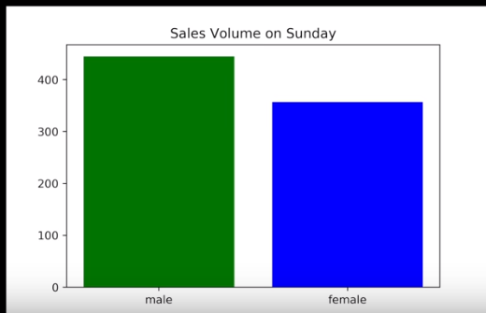
Data analysis/ visualization
To help you understand these lets take a example
You are a data analyst working for a company some products online
And as a data analyst your might job like this

Slide 18
Explanation of this graph different
This product is more popular for men comparing women
This difference may be by chance
Men buy more products on Sunday but not the other day

Slide 19
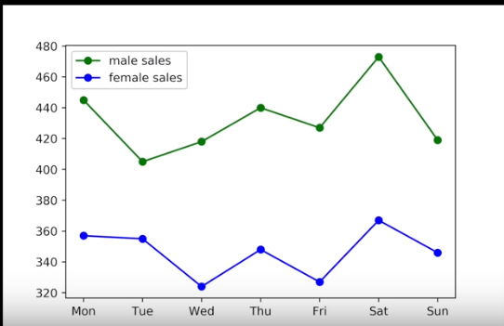
For answer this you create another graph
For all 7 days

Slide 20
The most popular libraries is
Matplotlib
One of the most popular
Easy to get started
Other libraries depend on it like seaborn
For leaning these in python I recommended
Khan Academy and Coursera

Slide 21
Scripting
Usually recommended to writing small programs for simple task
Like a email extractor
Counting keywords
Python for scripting is good because of
Simple syntax
Easy to learn
Quick to write/test

Slide 22
Game Development
You can developed game in python by using library pygiet
But it is not the popular gaming engine
You can create your final project but if you are serious about game development kindly select unity with C#

Slide 23
Desktop Application
You can create application using tkinter or QT but it is not popular for these of purpose
For desktop application most popular languages are
Java,C# and C++

Slide 24


Slide 25


Slide 26
For internship or any other quires
You can contact me on
umerfsniper@gmail.come
Umer.hyd@zabtech.edu.pk
0331-2602913

